Slide 1
Field and Lab Class Registration (CVent)
North Carolina Department of Transportation
Materials and Tests Unit Classes
Asphalt
Concrete
Soils
Labs
Welding

Slide 2
What does CVent do for everyone?
Through CVent Registrants can
Register for class – selection of more than one class
Have the ability to modify his/her registrations
Pay for classes
Receive a receipt for monies spent on classes
Receive detail confirmation for class information
CVent allows others to register for an individual
CVent groups classes together for an individual
CVent tracks all financial transactions
Check and balance for class attendees
Registrations are accounted for through CVent
Allows for refunds
Allows mass emails to registrants regarding class changes or cancellations

Slide 3
Field and Lab Classes 2021
2021 Statistics
There were 250 classes taught by the Materials and Tests Unit in 2021
There were 3,749 people registered for classes - after refunds, cancellations, and cancelled classes 2,381 individuals were trained
There were 356 refunds made
$856,085.00 amount collected from training fees (not near enough to cover all of training expenses from registrations)

Slide 4
Process
Trainers set up venues for classes
Master spreadsheet is created for classes for each calendar year
Classes are added to CVent on a quarterly basis
Registration opens
Registrants register for classes
Registrations are posted to Vendor daily
Registrants receive class confirmation from CVent
Classes close 5 days prior to class start date so class can be finalized for trainers (staff compares CVent to Vendor to make sure all attendees are accounted for, prepare and send to instructor email for those that have been removed from class and issued refunds, post information in house on files - prepare folders for class)

Slide 5
Registrants attend class – take exams
Trainers grade exams, type spreadsheet with grades for posting to webpage - forwards to training office
Trainers forward written exams and all necessary documents to training office
Training staff post grade spreadsheet to web page
Grades are posted to Vendor (HiCams) once exams are received from trainer
If attendee passes his/her exam and all prerequisites are met, certification is made by training staff
Certification status for individuals can be reviewed @ the Approved Products web site (below) NEXT SCREEN
https://apps.ncdot.gov/vendor/approvedproducts/
Google NCDOT Vendor Approved products to find website.

Slide 6
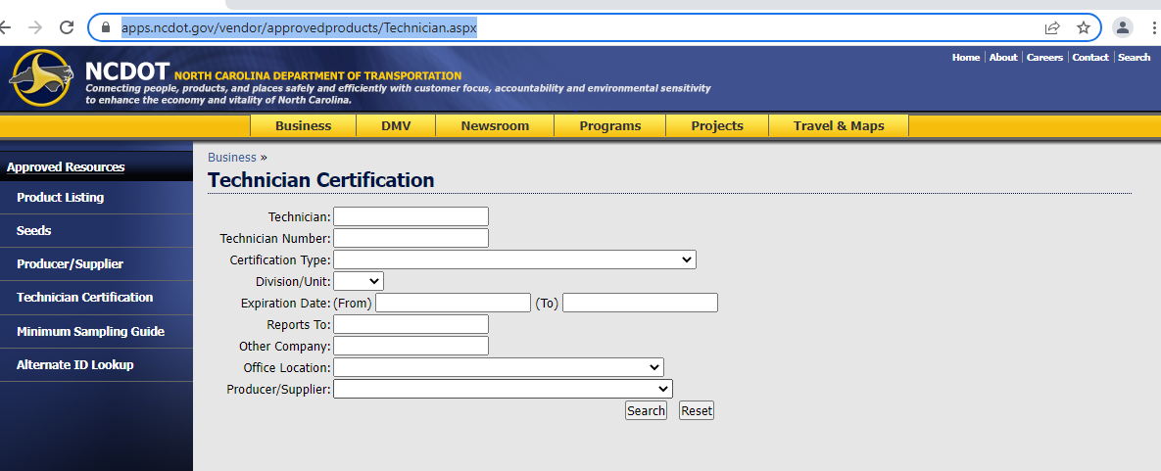
Approved Products Listing (to view Certifications)
Link https://apps.ncdot.gov/vendor/approvedproducts/Technician.aspx

Slide 7
Enter name in Technician Field. Press Enter, names that match will pop up. Click on name to select.

Slide 8
All certifications for individual will appear, this screen can be printed for view of records.

Slide 9
Now to Register

Slide 10
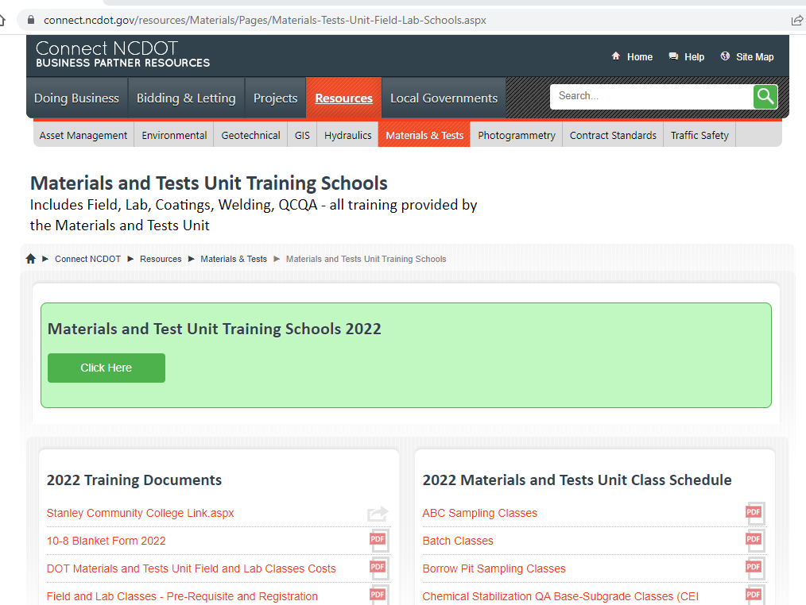
Accessing the Registration Program
Applicants can search (google) Materials and Tests Training and select the below option
connect.ncdot.gov
or use the below link to connect https://connect.ncdot.gov/resources/Materials/Pages/Materials-Tests-Unit-Field-Lab-Schools.aspx

Slide 11
Click Click Here inside the Materials and Test Schools 2022 Green Box
Notice below the training box on the left side of screen shows additional documents for training assistance.
On the right side of screen are PDF files showing the tentative class schedule for entire year. This assists users that need to see what we will be offering at a later date.

Slide 12
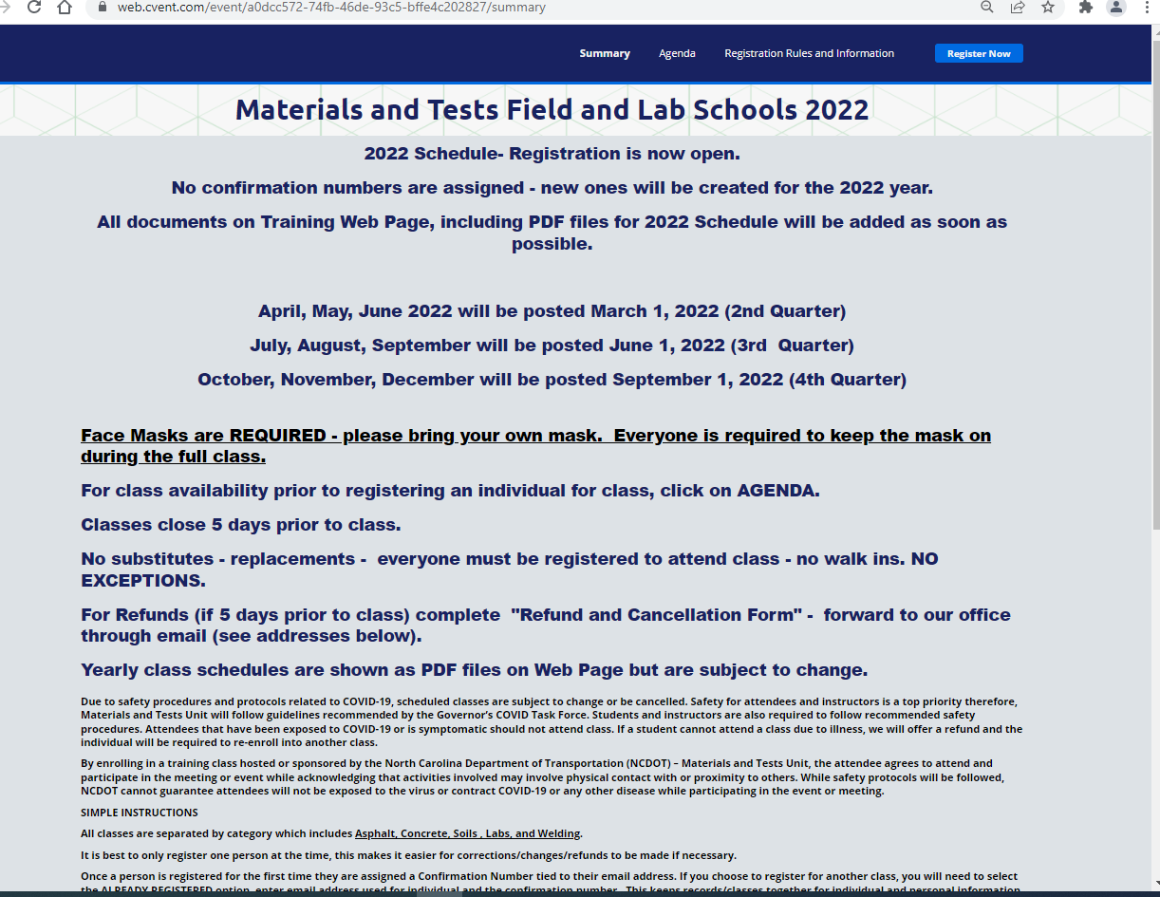
This first screen is referred to as the Summary Page. The Summary Page is where Registration starts.
Please read all the information on the Summary Page for it is vital for the operation of the registration process and for all to understand rules that apply.

Slide 13
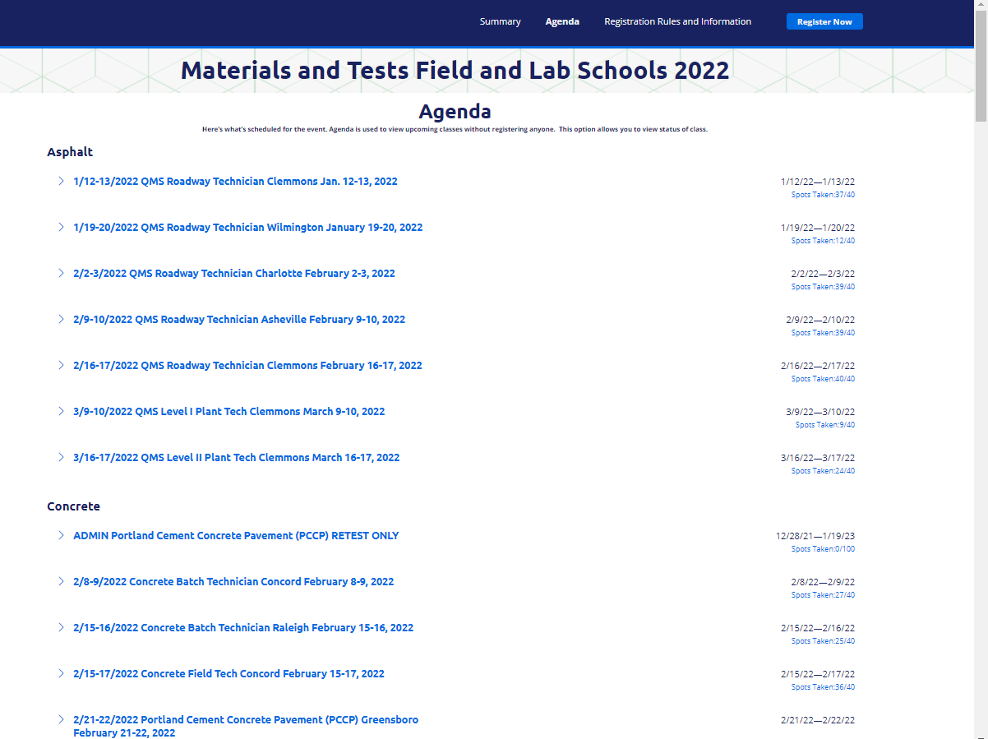
Agenda page allows one to view classes and available slots prior to registering.

Slide 14
To start Registration Click
Register Now

Slide 15
Personal Information
Fill out Personal Information fields.
Email Address – should be registrant’s information.
CC Email Address – should be the person completing the registration.
Both email addresses will receive the confirmation email once the registration is finalized.

Slide 16
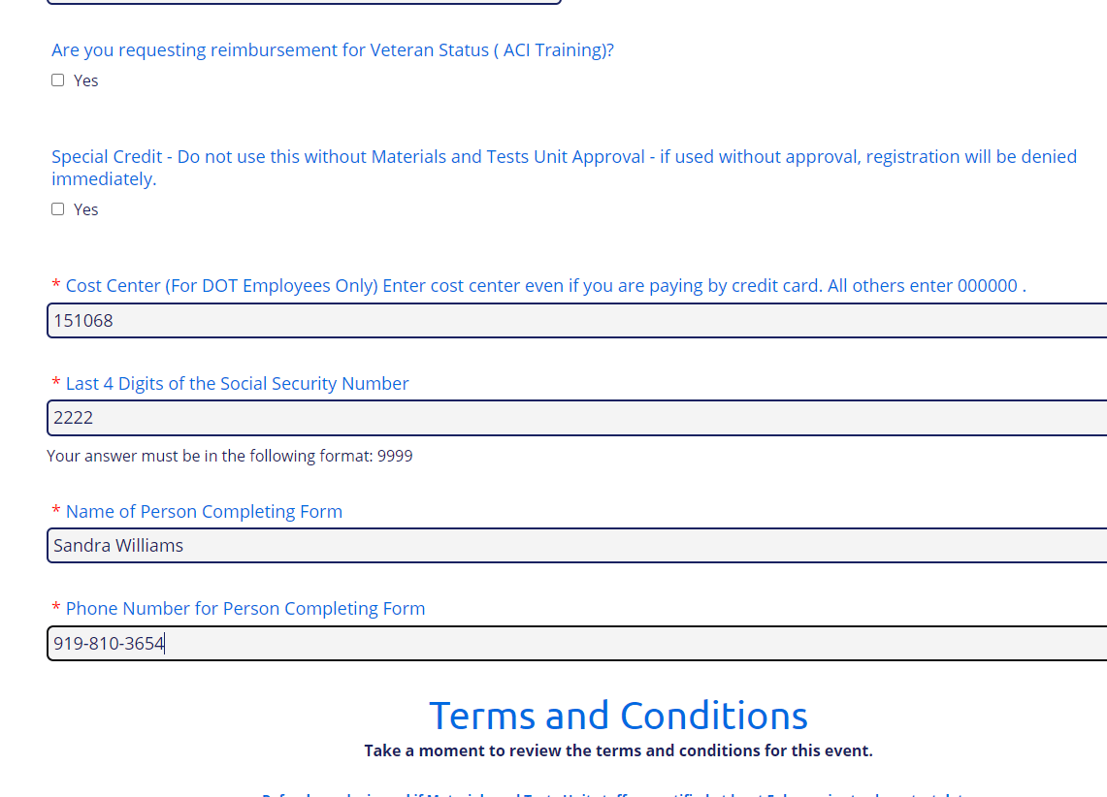
Special Credit - there are no credits existing for 2021 or 2022, field is only to be used if training staff request it be used for a payment.
Cost Center - DOT staff can use P-Card or Credit Card for payment, Cost Center still needs to be entered.
If Transfer of Funds is used for payment, this field is important so the monies can be moved from the DOT Cost Center to the Materials and Tests Unit Training account.

Slide 17
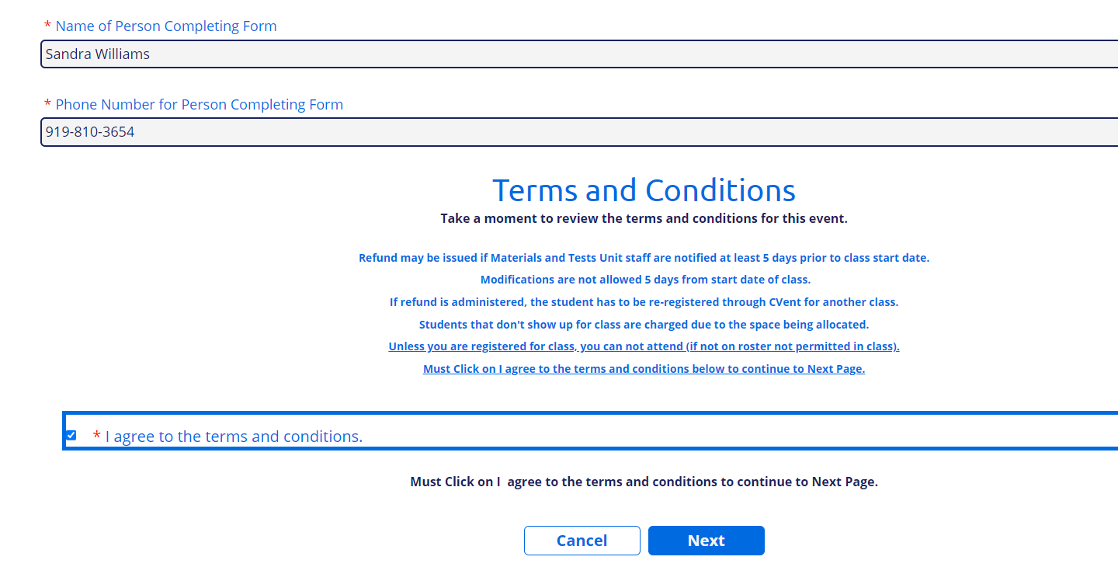
Please read terms and conditions.
Click on I agree box.
Click on Next.

Slide 18
Selecting Classes
After entering all the demographics, classes can be selected.
More than one can be selected at a time.
DO NOT unselect class if you add more classes during a modification process, you will not be charged for classes again.
There are five categories of classes - Asphalt, Concrete, Soils, Labs, and Welding.
Each category identifies classes within.
Within a Category classes are listed by Date of Class.
ADMIN CLASSES ARE FOR PAYMENT ONLY, you will be directed by training staff to use this selection.
Scroll to the bottom of page after selecting all the classes needed.

Slide 19
Individual Class information shows in each category with additional notes

Slide 20
Admin Classes are used for pay of class only – training staff will direct someone to use this entry.
Each Category of classes has this option.
Click on Drop down for selection of class type.
Once selection is made Click Select button.

Slide 21
Once a class is selected as shown, find other classes if necessary and select, to finish scroll to bottom of page to continue.

Slide 22
After selecting all classes needed, scroll to the bottom of page.
Click I Agree to continue.
(This statement reminds registrants classes close 5 days prior to class start date and no substitutions.)
Click on Next.

Slide 23
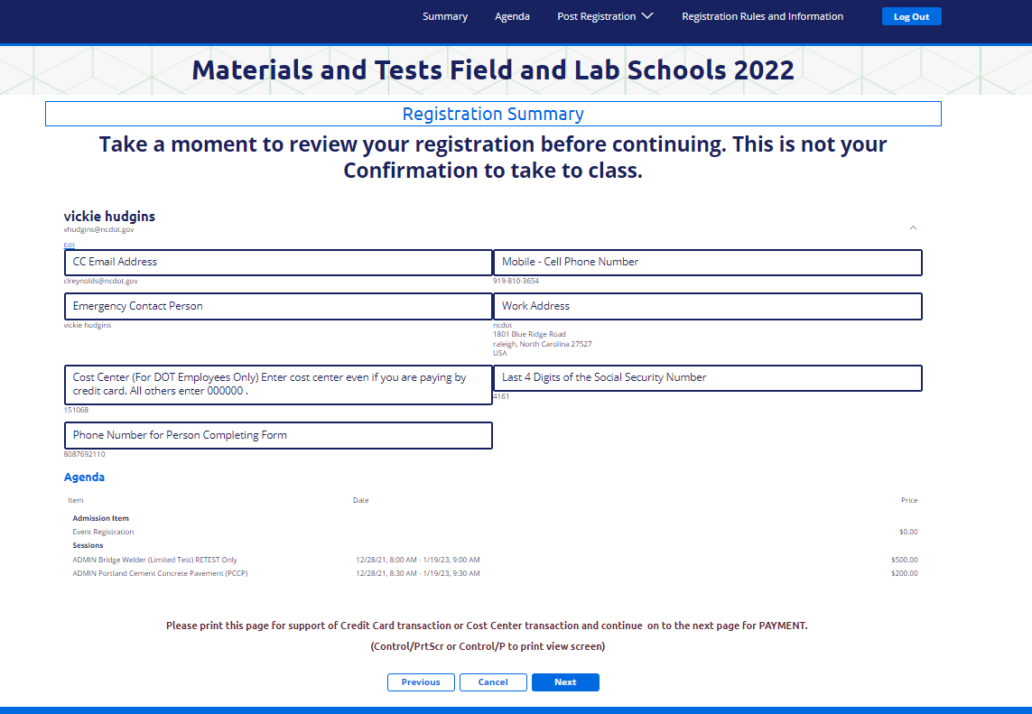
Registration summary page shows detail of information, including classes and cost. Above pages are not a confirmation, must click next. Payment information is entered on order summary page.

Slide 24
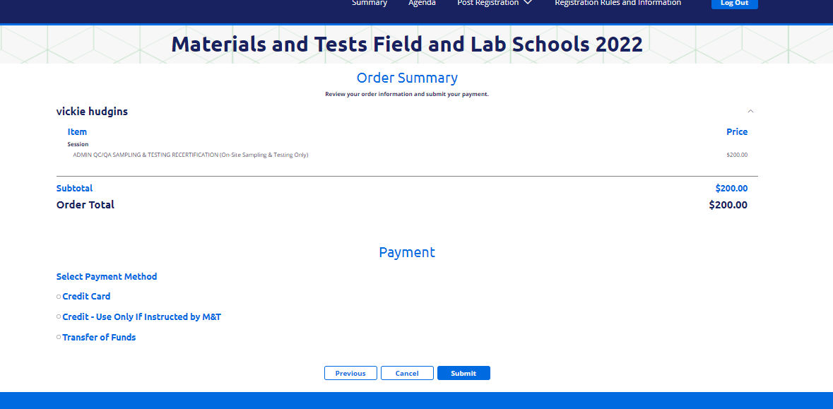
Order Summary shows total of class charges.
Click on type of payment (DOT staff should use credit card or Transfer of Funds - for Transfer of Funds cost center should have been entered on personal information page).
Once selection is made - click Submit

Slide 25
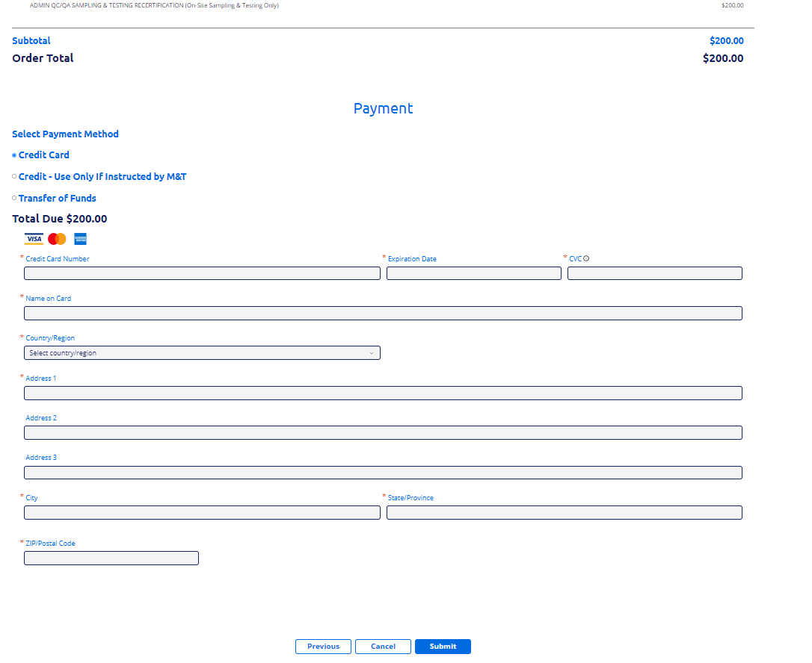
Once Credit Card information is entered, click on Submit

Slide 26
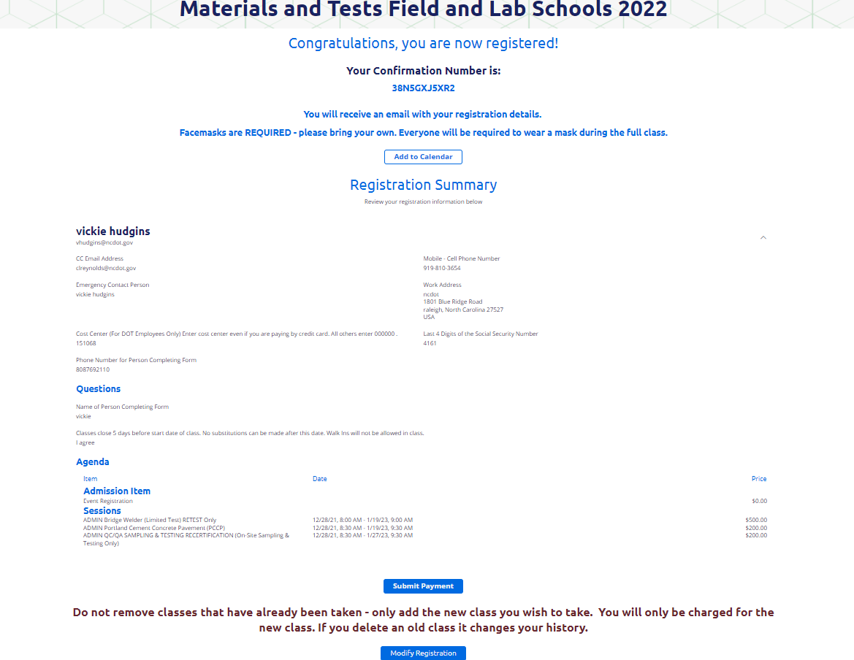
You should receive this message letting you know that your registration is successful.
A confirmation email will be sent to both email addresses entered on registration.
Once a person has registered for a class, to register for another class they must use the confirmation number assigned and use the Already Registered function.
This keeps all their classes together under one name.

Slide 27
Conclusion
Once the registration process is completed, a confirmation email will be sent out to the registrant and the cc email entered on the demographics page.
Confirmation emails are lengthy; however, it provides all the information the registrant will need including class information.
Contacts for assistance
Vickie Hudgins vhudgins@ncdot.Gov
(919) 329-4241
Curtina Reynolds clreynolds@ncdot.Gov
(919) 329-4240
Sandra Williams shwilliams3@ncdot.Gov
(919) 810-3654

